Slide 1

Chapter 12
Heaps and Priority Queues

Slide 2
Chapter Scope
Heaps, conceptually
Using heaps to solve problems
Heap implementations
Using heaps to implement priority queues

Slide 3
Heaps
A heap is a complete binary tree in which each element is less than or equal to both of its children
So a heap has both structural and ordering constraints
As with binary search trees, there are many possible heap configurations for a given set of elements
Our definition above is really a minheap
A similar definition could be made for a maxheap

Slide 4
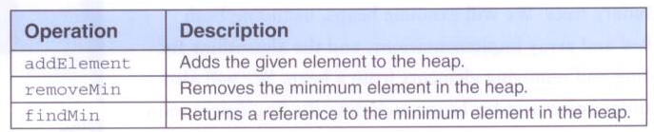
Heaps
Operations on a heap:

Slide 5
package jsjf;
/**
* HeapADT defines the interface to a Heap.
*
* @author Lewis and Chase
* @version 4.0
*/
public interface HeapADT<T> extends BinaryTreeADT<T>
{
/**
* Adds the specified object to this heap.
*
* @param obj the element to be added to the heap
*/
public void addElement(T obj);
/**
* Removes element with the lowest value from this heap.
*
* @return the element with the lowest value from the heap
*/
public T removeMin();
/**
* Returns a reference to the element with the lowest value in
* this heap.
*
* @return a reference to the element with the lowest value in the heap
*/
public T findMin();
}

Slide 6
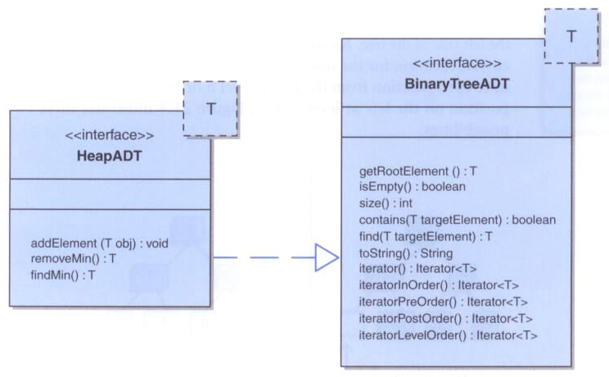
Heaps

Slide 7
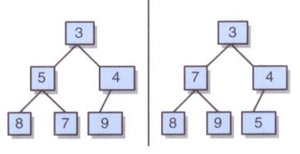
Heaps
Two minheaps containing the same data:

Slide 8
Adding a New Element
To add an element to the heap, add the element as a leaf, keeping the tree complete
Then, move the element up toward the root, exchanging positions with its parent, until the relationship among the elements is appropriate
This will guarantee that the resulting tree will conform to the heap criteria

Slide 9
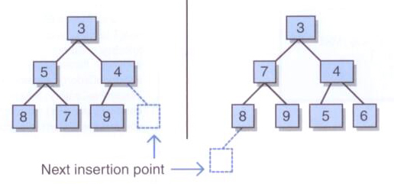
Adding a New Element
The initial insertion point for a new element in a heap:

Slide 10
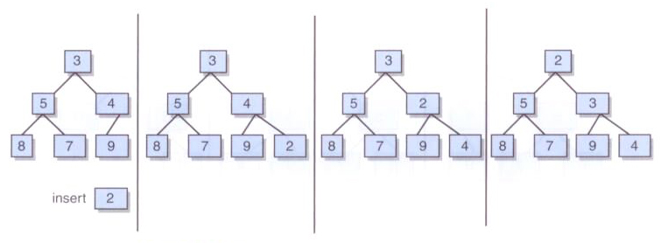
Adding a New Element
Inserting an element and moving it up the tree as far as appropriate:

Slide 11
Removing the Min Element
Remove the root (min) and reconstruct the heap
First, move the last leaf of the tree to be the new root of the tree
Then, move it down the tree as needed until the relationships among the elements is appropriate
In particular, compare the element to the smaller of its children and swap them if the child is smaller

Slide 12
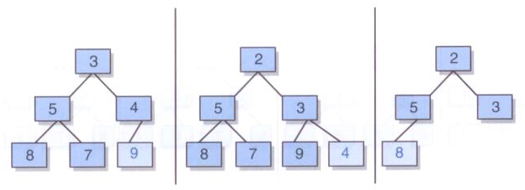
Removing the Min Element
The element to replace the root is the "last leaf" in the tree:

Slide 13
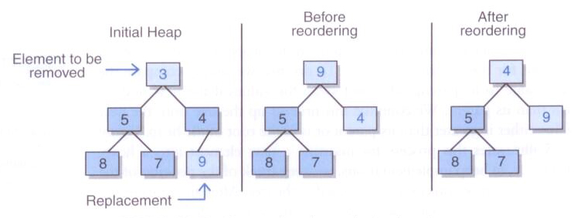
Removing the Min Element

Slide 14
Priority Qeueus
Recall that a FIFO queue removes elements in the order in which they were added
A priority queue removes elements in priority order, independent of the order in which they were added
Priority queues are helpful in many scheduling situations
A heap is a classic mechanism for implementing priority queues

Slide 15
/**
* PrioritizedObject represents a node in a priority queue containing a
* comparable object, arrival order, and a priority value.
*
* @author Lewis and Chase
* @version 4.0
*/
public class PrioritizedObject<T> implements Comparable<PrioritizedObject>
{
private static int nextOrder = 0;
private int priority;
private int arrivalOrder;
private T element;
/**
* Creates a new PrioritizedObject with the specified data.
*
* @param element the element of the new priority queue node
* @param priority the priority of the new queue node
*/
public PrioritizedObject(T element, int priority)
{
this.element = element;
this.priority = priority;
arrivalOrder = nextOrder;
nextOrder++;
}

Slide 16
/**
* Returns the element in this node.
*
* @return the element contained within the node
*/
public T getElement()
{
return element;
}
/**
* Returns the priority value for this node.
*
* @return the integer priority for this node
*/
public int getPriority()
{
return priority;
}
/**
* Returns the arrival order for this node.
*
* @return the integer arrival order for this node
*/
public int getArrivalOrder()
{
return arrivalOrder;
}

Slide 17
/**
* Returns a string representation for this node.
*
*/
public String toString()
{
return (element + " " + priority + " " + arrivalOrder);
}
/**
* Returns 1 if the this object has higher priority than
* the given object and -1 otherwise.
*
* @param obj the object to compare to this node
* @return the result of the comparison of the given object and
* this one
*/
public int compareTo(PrioritizedObject obj)
{
int result;
if (priority > obj.getPriority())
result = 1;
else if (priority < obj.getPriority())
result = -1;
else if (arrivalOrder > obj.getArrivalOrder())
result = 1;
else
result = -1;
return result;
}
}

Slide 18
import jsjf.*;
/**
* PriorityQueue implements a priority queue using a heap.
*
* @author Lewis and Chase
* @version 4.0
*/
public class PriorityQueue<T> extends ArrayHeap<PrioritizedObject<T>>
{
/**
* Creates an empty priority queue.
*/
public PriorityQueue()
{
super();
}
/**
* Adds the given element to this PriorityQueue.
*
* @param object the element to be added to the priority queue
* @param priority the integer priority of the element to be added
*/
public void addElement(T object, int priority)
{
PrioritizedObject<T> obj = new PrioritizedObject<T>(object, priority);
super.addElement(obj);
}

Slide 19
/**
* Removes the next highest priority element from this priority
* queue and returns a reference to it.
*
* @return a reference to the next highest priority element in this queue
*/
public T removeNext()
{
PrioritizedObject<T> obj = (PrioritizedObject<T>)super.removeMin();
return obj.getElement();
}
}

Slide 20
Implementing Heaps with Links
The operations on a heap require moving up the heap as well as down
So we'll add a parent pointer to the HeapNode class, which is itself based on the node for a binary tree
In the heap itself, we'll keep track of a pointer so that we always know where the last leaf is

Slide 21
package jsjf;
/**
* HeapNode represents a binary tree node with a parent pointer for use
* in heaps.
*
* @author Lewis and Chase
* @version 4.0
*/
public class HeapNode<T> extends BinaryTreeNode<T>
{
protected HeapNode<T> parent;
/**
* Creates a new heap node with the specified data.
*
* @param obj the data to be contained within the new heap node
*/
public HeapNode(T obj)
{
super(obj);
parent = null;
}

Slide 22
/**
* Return the parent of this node.
*
* @return the parent of the node
*/
public HeapNode<T> getParent()
{
return parent;
}
/**
* Sets the element stored at this node.
*
* @param the element to be stored
*/
public void setElement(T obj)
{
element = obj;
}
/**
* Sets the parent of this node.
*
* @param node the parent of the node
*/
public void setParent(HeapNode<T> node)
{
parent = node;
}
}

Slide 23
package jsjf;
import jsjf.exceptions.*;
/**
* LinkedHeap implements a heap.
*
* @author Lewis and Chase
* @version 4.0
*/
public class LinkedHeap<T> extends LinkedBinaryTree<T> implements HeapADT<T>
{
public HeapNode<T> lastNode;
public LinkedHeap()
{
super();
}

Slide 24
/**
* Adds the specified element to this heap in the appropriate
* position according to its key value.
*
* @param obj the element to be added to the heap
*/
public void addElement(T obj)
{
HeapNode<T> node = new HeapNode<T>(obj);
if (root == null)
root=node;
else
{
HeapNode<T> nextParent = getNextParentAdd();
if (nextParent.getLeft() == null)
nextParent.setLeft(node);
else
nextParent.setRight(node);
node.setParent(nextParent);
}
lastNode = node;
modCount++;
if (size() > 1)
heapifyAdd();
}

Slide 25
/**
* Returns the node that will be the parent of the new node
*
* @return the node that will be the parent of the new node
*/
private HeapNode<T> getNextParentAdd()
{
HeapNode<T> result = lastNode;
while ((result != root) && (result.getParent().getLeft() != result))
result = result.getParent();
if (result != root)
if (result.getParent().getRight() == null)
result = result.getParent();
else
{
result = (HeapNode<T>)result.getParent().getRight();
while (result.getLeft() != null)
result = (HeapNode<T>)result.getLeft();
}
else
while (result.getLeft() != null)
result = (HeapNode<T>)result.getLeft();
return result;
}

Slide 26
/**
* Reorders this heap after adding a node.
*/
private void heapifyAdd()
{
T temp;
HeapNode<T> next = lastNode;
temp = next.getElement();
while ((next != root) &&
(((Comparable)temp).compareTo(next.getParent().getElement()) < 0))
{
next.setElement(next.getParent().getElement());
next = next.parent;
}
next.setElement(temp);
}

Slide 27
/**
* Remove the element with the lowest value in this heap and
* returns a reference to it. Throws an EmptyCollectionException
* if the heap is empty.
*
* @return the element with the lowest value in this heap
* @throws EmptyCollectionException if the heap is empty
*/
public T removeMin() throws EmptyCollectionException
{
if (isEmpty())
throw new EmptyCollectionException("LinkedHeap");
T minElement = root.getElement();
if (size() == 1)
{
root = null;
lastNode = null;
}

Slide 28
else
{
HeapNode<T> nextLast = getNewLastNode();
if (lastNode.getParent().getLeft() == lastNode)
lastNode.getParent().setLeft(null);
else
lastNode.getParent().setRight(null);
((HeapNode<T>)root).setElement(lastNode.getElement());
lastNode = nextLast;
heapifyRemove();
}
modCount++;
return minElement;
}

Slide 29
/**
* Returns the node that will be the new last node after a remove.
*
* @return the node that willbe the new last node after a remove
*/
private HeapNode<T> getNewLastNode()
{
HeapNode<T> result = lastNode;
while ((result != root) && (result.getParent().getLeft() == result))
result = result.getParent();
if (result != root)
result = (HeapNode<T>)result.getParent().getLeft();
while (result.getRight() != null)
result = (HeapNode<T>)result.getRight();
return result;
}

Slide 30
/**
* Reorders this heap after removing the root element.
*/
private void heapifyRemove()
{
T temp;
HeapNode<T> node = (HeapNode<T>)root;
HeapNode<T> left = (HeapNode<T>)node.getLeft();
HeapNode<T> right = (HeapNode<T>)node.getRight();
HeapNode<T> next;
if ((left == null) && (right == null))
next = null;
else if (right == null)
next = left;
else if (((Comparable)left.getElement()).compareTo(right.getElement()) < 0)
next = left;
else
next = right;
temp = node.getElement();

Slide 31
while ((next != null) &&
(((Comparable)next.getElement()).compareTo(temp) < 0))
{
node.setElement(next.getElement());
node = next;
left = (HeapNode<T>)node.getLeft();
right = (HeapNode<T>)node.getRight();
if ((left == null) && (right == null))
next = null;
else if (right == null)
next = left;
else if (((Comparable)left.getElement()).compareTo(right.getElement()) < 0)
next = left;
else
next = right;
}
node.setElement(temp);
}

Slide 32
Implementing Heaps with Arrays
Since a heap is a complete tree, an array-based implementation is reasonable
As previously discussed, a parent element at index n will have children stored at index 2n+1 and 2n+2 of the array
Conversely, for any node other than the root, the parent of the node is found at index (n-1)/2

Slide 33
package jsjf;
import java.util.*;
import jsjf.exceptions.*;
/**
* ArrayBinaryTree implements the BinaryTreeADT interface using an array
*
* @author Lewis and Chase
* @version 4.0
*/
public class ArrayBinaryTree<T> implements BinaryTreeADT<T>, Iterable<T>
{
private static final int DEFAULT_CAPACITY = 50;
protected int count;
protected T[] tree;
protected int modCount;
/**
* Creates an empty binary tree.
*/
public ArrayBinaryTree()
{
count = 0;
tree = (T[]) new Object[DEFAULT_CAPACITY];
}

Slide 34
/**
* Creates a binary tree with the specified element as its root.
*
* @param element the element which will become the root of the new tree
*/
public ArrayBinaryTree(T element)
{
count = 1;
tree = (T[]) new Object[DEFAULT_CAPACITY];
tree[0] = element;
}

Slide 35
package jsjf;
import jsjf.exceptions.*;
/**
* ArrayHeap provides an array implementation of a minheap.
*
* @author Lewis and Chase
* @version 4.0
*/
public class ArrayHeap<T> extends ArrayBinaryTree<T> implements HeapADT<T>
{
/**
* Creates an empty heap.
*/
public ArrayHeap()
{
super();
}

Slide 36
/**
* Adds the specified element to this heap in the appropriate
* position according to its key value.
*
* @param obj the element to be added to the heap
*/
public void addElement(T obj)
{
if (count == tree.length)
expandCapacity();
tree[count] = obj;
count++;
modCount++;
if (count > 1)
heapifyAdd();
}

Slide 37
/**
* Reorders this heap to maintain the ordering property after
* adding a node.
*/
private void heapifyAdd()
{
T temp;
int next = count - 1;
temp = tree[next];
while ((next != 0) &&
(((Comparable)temp).compareTo(tree[(next-1)/2]) < 0))
{
tree[next] = tree[(next-1)/2];
next = (next-1)/2;
}
tree[next] = temp;
}

Slide 38
/**
* Remove the element with the lowest value in this heap and
* returns a reference to it. Throws an EmptyCollectionException if
* the heap is empty.
*
* @return a reference to the element with the lowest value in this heap
* @throws EmptyCollectionException if the heap is empty
*/
public T removeMin() throws EmptyCollectionException
{
if (isEmpty())
throw new EmptyCollectionException("ArrayHeap");
T minElement = tree[0];
tree[0] = tree[count-1];
heapifyRemove();
count--;
modCount--;
return minElement;
}

Slide 39
/**
* Reorders this heap to maintain the ordering property
* after the minimum element has been removed.
*/
private void heapifyRemove()
{
T temp;
int node = 0;
int left = 1;
int right = 2;
int next;
if ((tree[left] == null) && (tree[right] == null))
next = count;
else if (tree[right] == null)
next = left;
else if (((Comparable)tree[left]).compareTo(tree[right]) < 0)
next = left;
else
next = right;
temp = tree[node];

Slide 40
while ((next < count) &&
(((Comparable)tree[next]).compareTo(temp) < 0))
{
tree[node] = tree[next];
node = next;
left = 2 * node + 1;
right = 2 * (node + 1);
if ((tree[left] == null) && (tree[right] == null))
next = count;
else if (tree[right] == null)
next = left;
else if (((Comparable)tree[left]).compareTo(tree[right]) < 0)
next = left;
else
next = right;
}
tree[node] = temp;
}

Slide 41
Heap Sort
Given the ordering property of a heap, it is natural to think of using a heap to sort a list of numbers
A heap sort sorts a set of elements by adding each one to a heap, then removing them one at a time
The smallest element comes off the heap first, so the sequence will be in ascending order

Slide 42
package jsjf;
/**
* HeapSort sorts a given array of Comparable objects using a heap.
*
* @author Lewis and Chase
* @version 4.0
*/
public class HeapSort<T>
{
/**
* Sorts the specified array using a Heap
*
* @param data the data to be added to the heapsort
*/
public void HeapSort(T[] data)
{
ArrayHeap<T> temp = new ArrayHeap<T>();
// copy the array into a heap
for (int i = 0; i < data.length; i++)
temp.addElement(data[i]);
// place the sorted elements back into the array
int count = 0;
while (!(temp.isEmpty()))
{
data[count] = temp.removeMin();
count++;
}
}
}

